Slide 1
Neil’s Pizzeria
Prototype

Slide 2

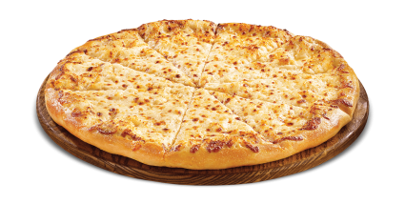
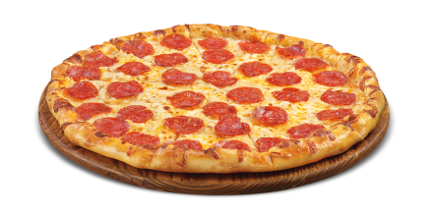
Neil’s Pizzeria
Logo
Home
About Us
Menu
Order Online
Directions/Contact Us
Welcome to Neil’s Pizzeria!
Traditional Italian Food
588 Valley Rd, Wayne, NJ 07470
(973) 305-0405

Slide 3
Neil’s Pizzeria
Home
About Us
Menu
Order Online
Directions/Contact Us
About Us
About Us Information…
*This is the format for all of the pages*
588 Valley Rd, Wayne, NJ 07470
(973) 305-0405

Slide 4
Neil’s Pizzeria
Home
About Us
Menu
Order Online
Directions/Contact Us
Menu
Appetizers
Radio Buttons
Main Course
Radio Buttons
Dessert
Radio Buttons
Drinks
Radio Buttons
*This is the format for all of the pages*
Images
588 Valley Rd, Wayne, NJ 07470
(973) 305-0405

Slide 5
Neil’s Pizzeria
Home
About Us
Menu
Order Online
Directions/Contact Us
Order Online
Appetizers
Radio Buttons
Main Course
Radio Buttons
Dessert
Radio Buttons
Drinks
Radio Buttons
Submit button (submission confirmed)
*This is the format for all of the pages*
Images
588 Valley Rd, Wayne, NJ 07470
(973) 305-0405

Slide 6
Neil’s Pizzeria
Home
About Us
Menu
Order Online
Directions/Contact Us
Directions/Contact Us
Google Maps of place, ability to zoom in and out, and more
Address
Phone Number
Hours
588 Valley Rd, Wayne, NJ 07470
(973) 305-0405

